Slide 1
Error Correction and Detection
CSC 223

Slide 2
Introduction to errors
As you might expect, a number of errors can occur during data transmission. From a simple interference to a massive outage, transmitted data—both analog and digital—is susceptible to many types of noise and errors. Copper-based media have traditionally been plagued by many types of interference and noise.
Satellite, microwave, and radio networks are also prone to interference and crosstalk. Even fiber-optic cables can introduce errors into a transmission system, although the probability of this happening is less than with the other types of media.

Slide 3
Noise
Noise is an unwanted energy from sources other than the transmitter. Several types of noise may corrupt the signal.
Thermal Noise: Thermal noise is caused by random motion of electrons in a wire, which creates an extra signal not originally sent by the transmitter. The thermal noise is also known as white noise.
Cross talk: Cross talk is caused by inductive coupling between two wires that are close to each other. One wire acts as a sending antenna and the other acts as a receiving antenna.

Slide 4
Noise
Impulse Noise: Impulse noise is caused by spikes (a signal with high energy in a very short period of time) on the power line, lighting or other causes. For digital data, impulse noise can wipe out one or more bits.
Induced Noise: Induced noise come from the source such that motor and appliances. These devices act as a sending antenna and transmission media acts as a receiving antenna.

Slide 5
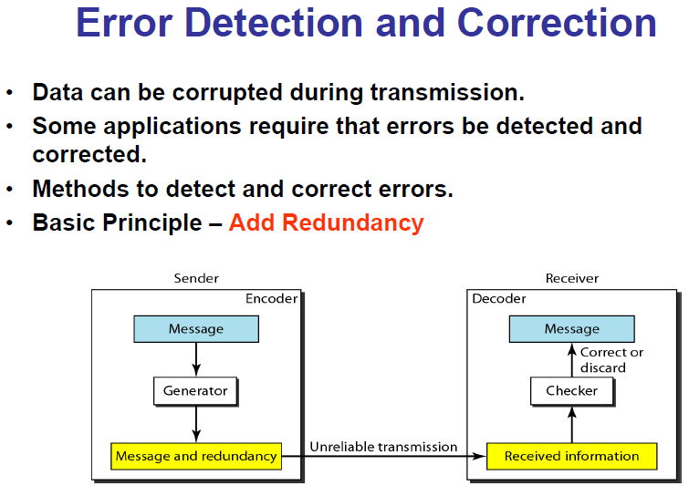

Slide 6

Types of Errors
Single bit error

Slide 7
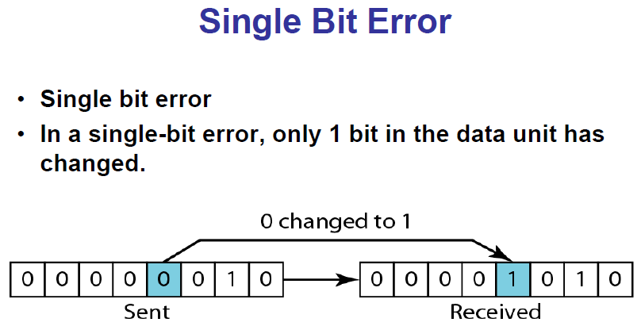

Slide 8
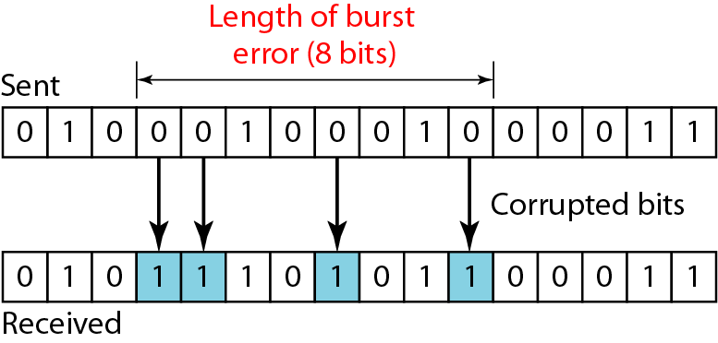
Burst Errors
Burst errors

Slide 9
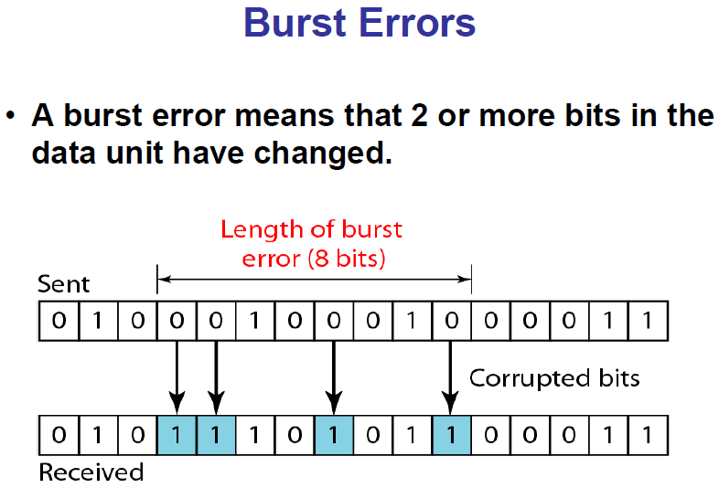

Slide 10
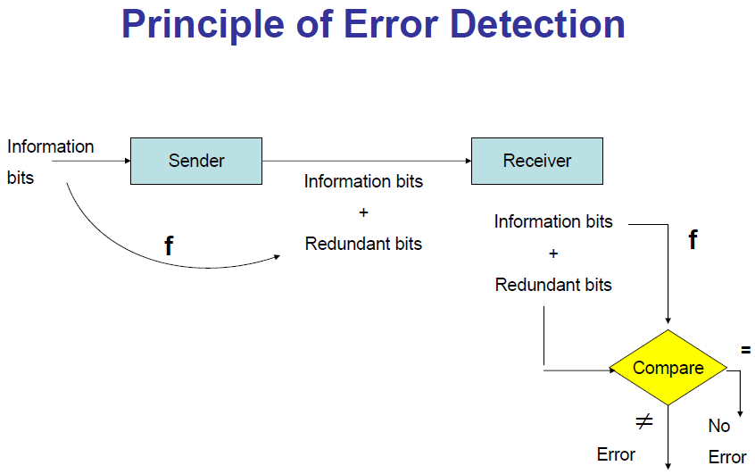

Slide 11

To detect or correct errors, redundant bits of data must be added

Slide 12
Error control schemes
Error control are techniques that enable reliable delivery of digital data over unreliable communication channels.
Many communication channels are subject to channel noise, and thus errors may be introduced during transmission from the source to a receiver.

Slide 13
Error detection techniques allow detecting such errors, while error correction enables reconstruction of the original data.
Error detection is the detection of errors caused by noise or other impairments during transmission from the transmitter to the receiver.

Slide 14
Error detection
Despite one’s best attempts at prevention, errors still occur. Because most data transferred over a communication line is important, it is usually necessary to apply an error-detection technique to the received data to ensure that no errors were introduced into the data during transmission. If an error is detected, a typical response is to perform some type of request for transmission.

Slide 15
Error detection
Error detection can be performed in several places within a communications model. One of the most common places is the data link layer.
When a device creates a frame of data at the data link layer, it inserts some type of error detection code. When the frame arrives at the next device in the transmission sequence, the receiver extracts the error-detection code and applies it to the data frame. Then, the data frame is reconstructed and sent to the next device in the transmission sequence.

Slide 16
Error detection techniques
Parity checks
Arithmetic checksum
Cyclic redundancy check

Slide 17
1. Simple parity check
A Simple parity is the easiest error-detection method to incorporate into a transmission system. It comes in two basic forms: even parity and odd parity. The basic concept of parity checking is that a bit is added to a string of bits to create either even parity or odd parity.

Slide 18
Simple parity check
With even parity, the 0 or 1 added to the string produces an even number of binary 1s.
With odd parity, the 0 or 1 added to the string produces an odd number of binary 1s.

Slide 19
Simple parity check
Suppose, the 7 bit ASCII character representing letter “k” 1101011—is transmitted and even parity is being applied. In this case, a parity bit of 1 would be added to the end of the bit stream, as follows: 11010111. There is now an even number (six) of 1s. (If odd parity were used, a 0 would be added at the end, resulting in 11010110.)

Slide 20
Simple parity check
Now, if a transmission error causes one of the bits to be flipped (the value is erroneously interpreted as a 0 instead of a 1, or vice versa), the error can be detected if the receiver understands that it needs to check for even parity.
Possible challenge?

Slide 21
2. Arithmetic checksum
Many higher-level protocols used on the Internet (such as TCP and IP) use a form of error detection in which the characters to be transmitted are “summed” together. This sum is then added to the end of the message and the message is transmitted to the receiving end.

Slide 22
The receiver accepts the transmitted message and performs the same summing operation, and essentially compares its sum with the sum that was generated by the transmitter. If the two sums agree, then no error occurred during the transmission. If the two sums do not agree, the receiver informs the transmitter that an error has occurred.

Slide 23
Arithmetic checksum
Let us consider the following example. Suppose we want to transmit the message “This is cool.” In ASCII, that message would appear in binary as: 1010100 1101000 1101001 1110011 0100000 1101001 1110011 0100000 1100011 1101111 1101111 1101100 0101110. (Do not forget the blanks between the words and the period at the end of the sentence.)

Slide 24
Sum of their decimal equivalents
84 + 104 + 105 + 115 + 32 + 105 + 115 + 32 + 99 + 111 + 111 + 108 + 46 = 1167
The sum 1167 is then added to the outgoing message and sent to the receiver. The receiver will take the same characters, add their ASCII values, and if there were no errors during transmission, should get the same sum of 1167.

Slide 25
Error correction/control
Error correction is the detection of errors and reconstruction of the original, error-free data

Slide 26
Error control
Once an error in the received data transmission stream is detected, what is the receiver going to do about it? The action that the receiver takes is called error control, which essentially involves taking one of three actions:
Toss the frame/packet.
Return a message to the transmitter asking it to resend the data packet that was in error.
Correct the error without retransmission.

Slide 27
Toss the frame/packet
If a data frame arrives at a frame relay switch and an error is detected after the cyclic checksum is performed, the frame is simply discarded. The rationale behind this action is twofold. Frame relay networks are created primarily of fiber-optic cable. Because fiber-optic cable is the medium least prone to generating errors, it is assumed that the rate of errors is low and that error control is unnecessary. The discarded frame will then be resent

Slide 28
Toss the frame/packet: example
Consider the example in which a company has a database application that sends database records across the country between two corporate locations. The database application (at the application layer) is using frame relay at the data link layer to transfer the actual records. If a record or part of a record is dropped by frame relay because of a transmission error, frame relay does not inform the application. Instead, the database application has to keep track of all records sent and received, and if one record does not arrive at the destination, the database application has to ask for a retransmission.

Slide 29
Return a message to sender
Stop and wait error control
In this approach the recipient sends an acknowledgement to the sender. A positive acknowledgement(ACK) from the recipient indicates that the data packet was received and the sender can send the next frame, a negative acknowledgement(NAK) means that the recipient didn’t receive and the sender needs to resend the previous data packet.

Slide 30
Return a message to sender
Sliding window error control
Sliding window error control is based on the sliding window protocol, which is a flow control scheme that allows a station to transmit a number of data packets at one time before receiving some form of acknowledgment.

Slide 31
Correct the error
Correcting the error seems like a reasonable solution. The data packet has been received, and error-detection logic has determined that an error has occurred. Why not simply correct the error and continue processing? Unfortunately, correcting an error is not that simple.

Slide 32
Correct the error
For a receiver to be able to fix an error—in a process called forward error correction—redundant information must be present so that the receiver knows which bit or bits are in error and what their original values were.

Slide 33
Error detection
Is most commonly realized using a suitable hash function (or checksum algorithm).
A hash function adds a fixed-length tag to a message, which enables receivers to verify the delivered message by recomputing the tag and comparing it with the one provided.

Slide 34
Repetition codes
A repetition code is a coding scheme that repeats the bits across a channel to achieve error-free communication.
Given a stream of data to be transmitted, the data is divided into blocks of bits. Each block is transmitted some predetermined number of times.

Slide 35
For example, to send the bit pattern "1011", the four-bit block can be repeated three times, thus producing "1011 1011 1011".
However, if this twelve-bit pattern was received as "1010 1011 1011" – where the first block is unlike the other two – it can be determined that an error has occurred.

Slide 36
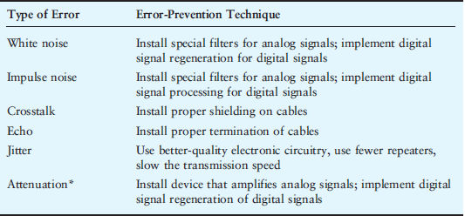
Error prevention

